Slide 1

Assignment 3: Predicting Future Outcomes
Ben Parkinson

Slide 2
Background
Both R and Python used for analysis
Sales data was found to be skewed to the right. There are outliers but the data has not been normalized for this analysis.
Data was imported and cleaned before being manipulated and wrangled to allow the visualisations to be created
The insights and recommendations are for use by the marketing team to better target their campaigns

Slide 3
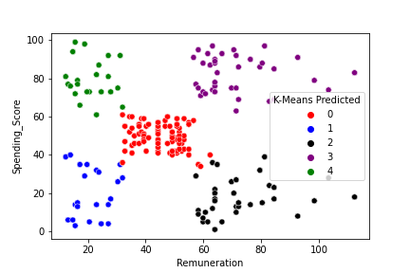
Groups within the customer base and Loyalty point accumulation
Insights
Customers fall into 5 distinct categories
There is correlation between remuneration, spending score and loyalty points earned

Slide 4
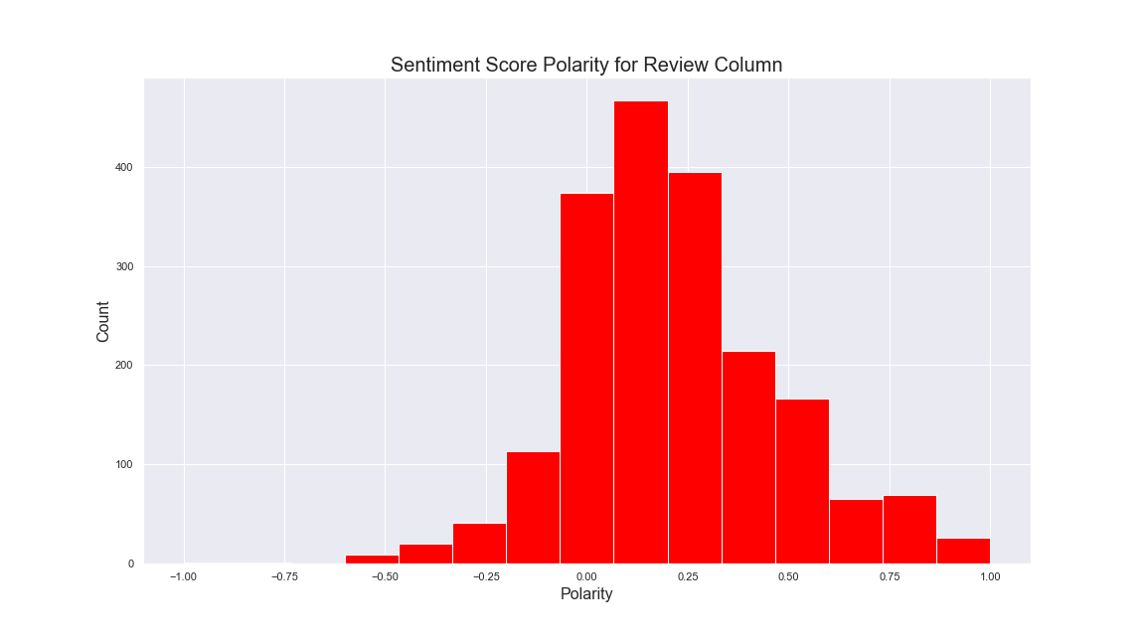
Using social data to inform marketing campaigns (Review)
Insights
Polarity of the review data is positive
Top words from the data are also positive
Some negative feedback used words such as ‘difficult’ and ‘boring’ to describe some games

Slide 5
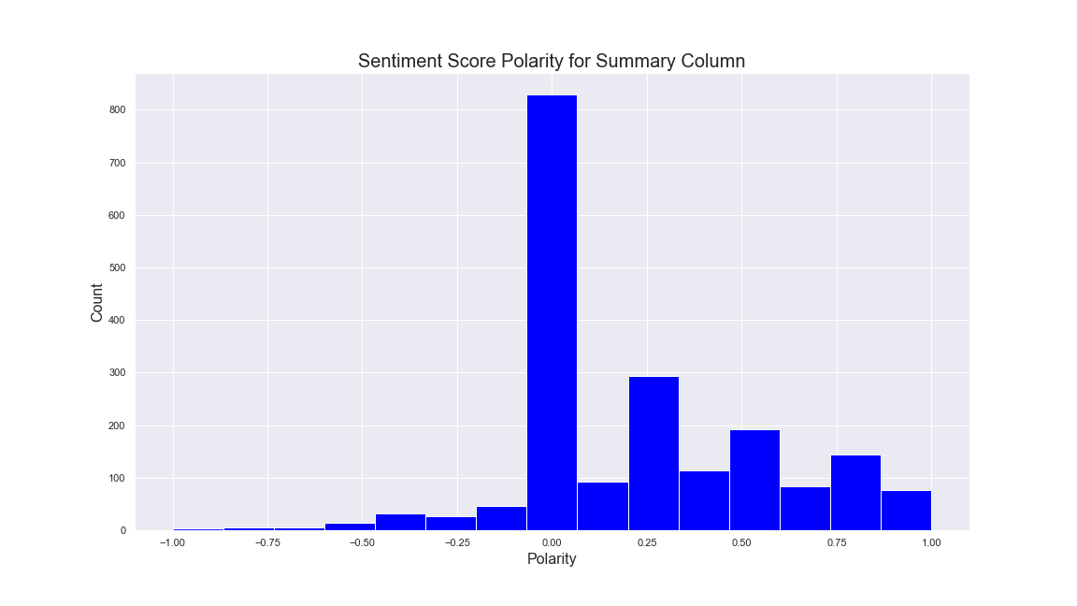
Using social data to inform marketing campaigns (Summary)
Insights
Polarity of the Summary data is positive
Most popular words used are all positive
One review from a professional is very positive about and Anger Management book

Slide 6
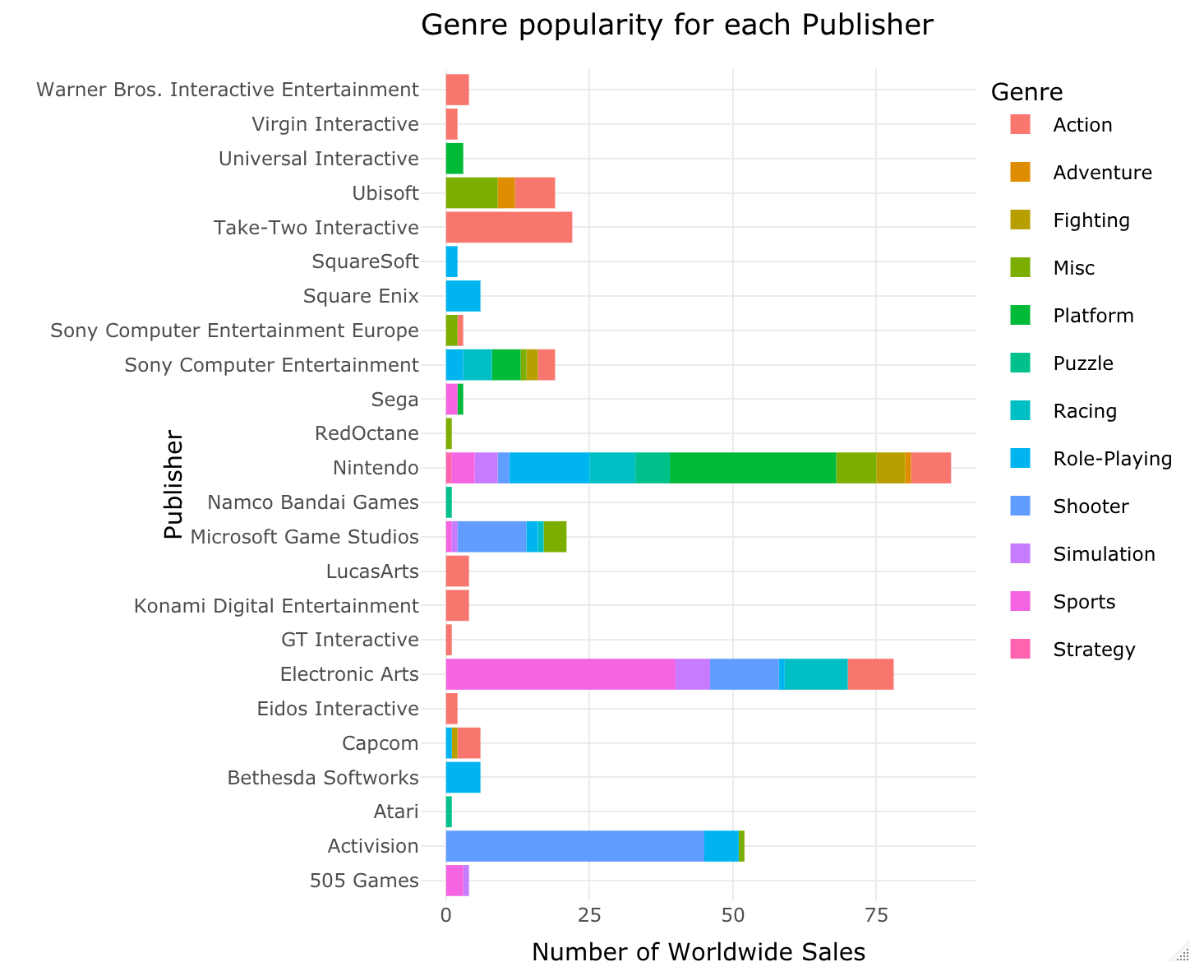
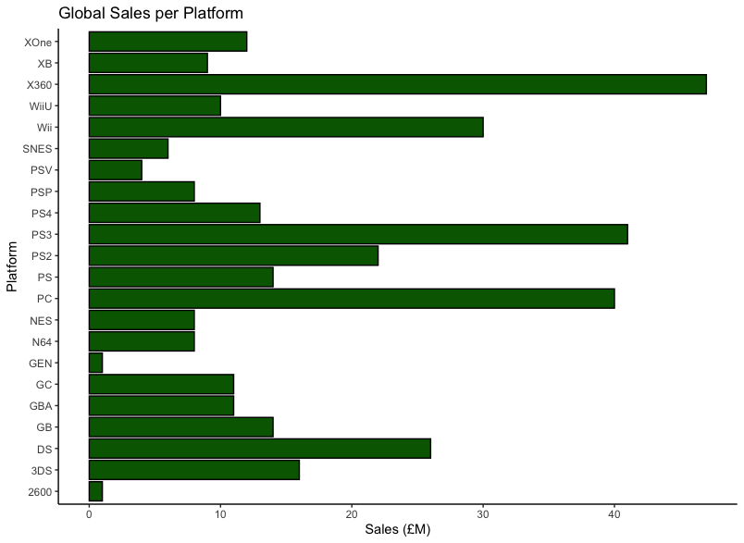
Impact of products on sales

Slide 7
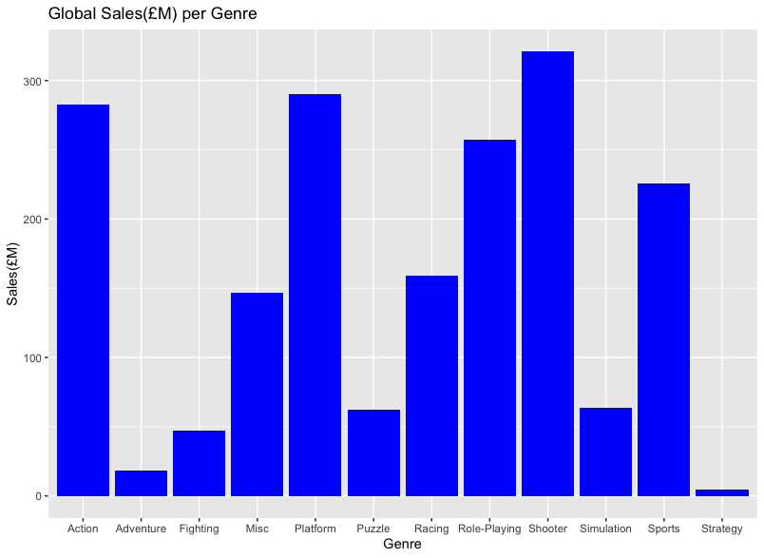
Impact of products on sales
Insights

Slide 8
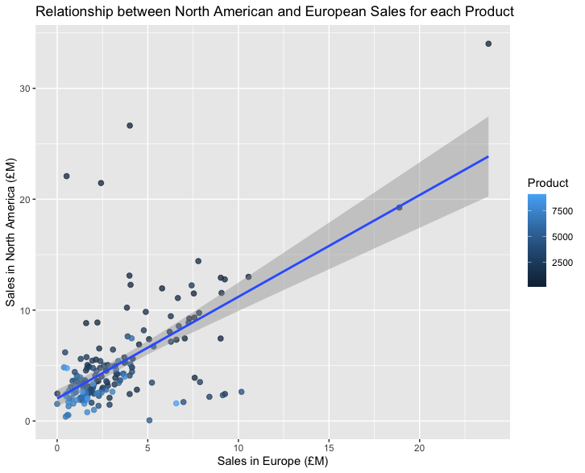
Relationship between EU and NA sales
Insights

Slide 9
Recommendations
There is a section of the customer base that are the lower earners but have a high spending score. Determine if there is a reason for this (ie. marketing campaign) and if there is then apply the same strategy to the other low earners.
Target marketing at high earners as a large number of these have a high spending score
The anger management product has very good reviews including a review from a professional. This product(s) could be marketed as being effective
Certain publishers are more popular for some genre’s than others. Marketing campaigns should be targeted by this.
Certain platforms generate much larger sales than others. These should also be targeted.
Targeting European and North American markets will be most beneficial as this is where the majority of Global sales are made currently

